Slide 1


PROJECT ON
Movie Sales Analysis
Presented By:
Name : KUCHANI VAMSHI
Batch : 456
Branch : DILSUKHNAGAR

Slide 2
About Me
My Name is Vamshi.
I have completed my Bachelor of Technology in Computer Science and Engineering.
Linked In : https://www.linkedin.com/in/kuchani-vamshi-14b356296/

Slide 3
Agenda
Introduction
Business Problem
  Business Problem
  Business Objective
  Problem Statement
Movie Overview & Time Trends
Gener & Rating Analysis
Top Performance & Box Office Insights
Correlation & Advance Metrics
Key Insights
Conclusion
Recommendation

Slide 4
Introduction
In today’s entertainment industry, movies are not just a source of art and storytelling but also a major business.
Producing a movie requires a huge investment of time, money, and effort from producers, directors, actors, and technicians.
Despite this, not all movies perform well at the box office, and poor performance can lead to significant financial losses for production houses.
This project focuses on analyzing movie sales data to identify revenue trends, top-performing movies, profitable genres, and regional performance.
By using data analysis and visualization techniques, the project aims to convert raw movie sales data into meaningful insights that support better business and investment decisions.

Slide 5
Business Problem
Business Problem
Nowadays, the movie industry has become a big business that requires a huge investment of time, money, and effort. Production houses spend heavily on actors, marketing, and promotions with the expectation of earning high returns. However, not all movies perform well at the box office. Many films fail to recover their budgets, leading to significant financial losses for production houses.
Business Objective
To analyze movie sales performance across different genres, and time periods and To identify high-performing and low-performing movies based on revenue, ratings, and audience response.
Problem Statement
Many movies fail to earn profits even after high investment due to poor planning and lack of insights. Analyzing movie sales data can help production houses understand what works and reduce financial losses.

Slide 6
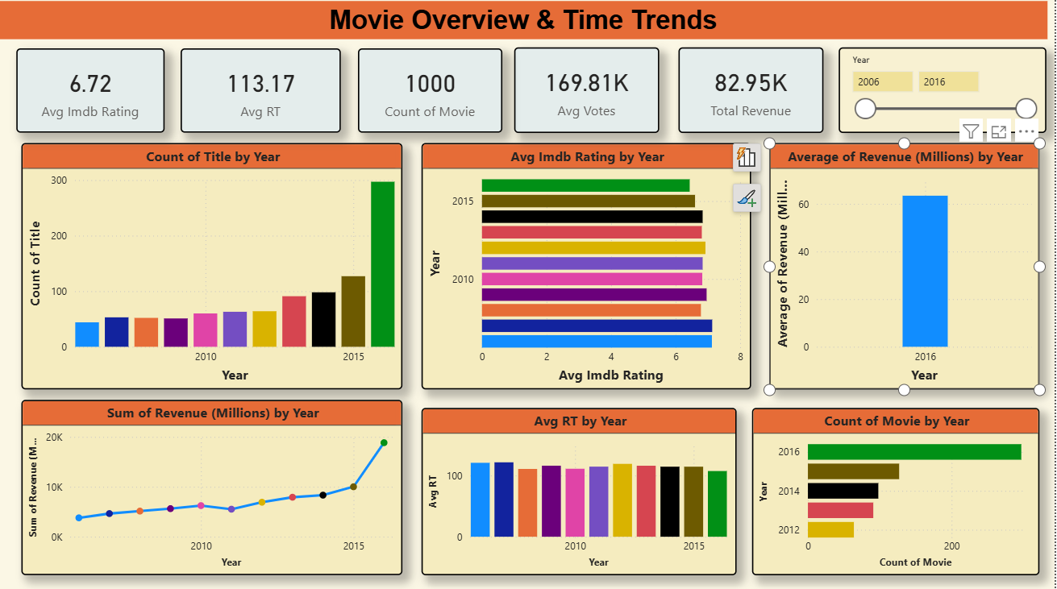

Slide 7
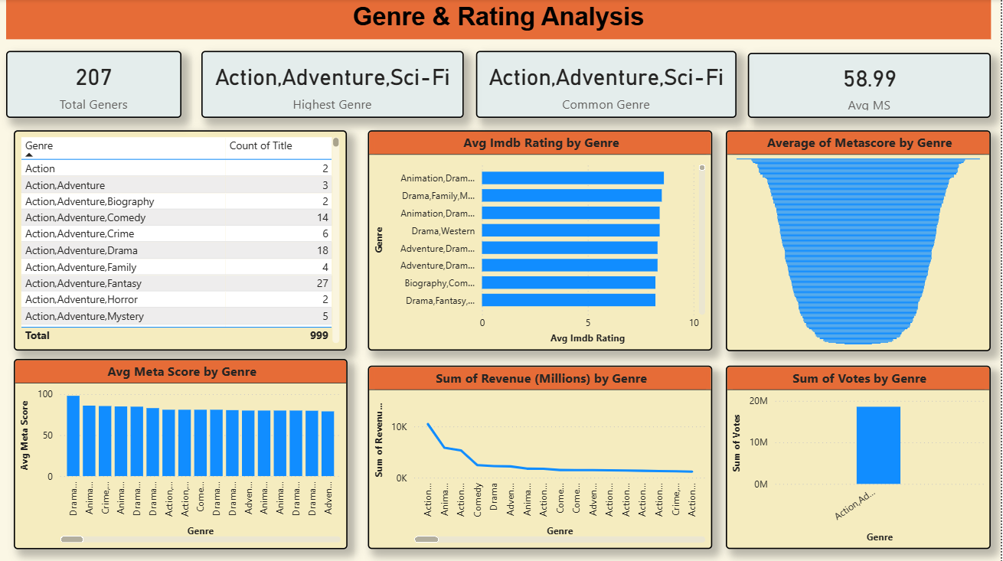

Slide 8
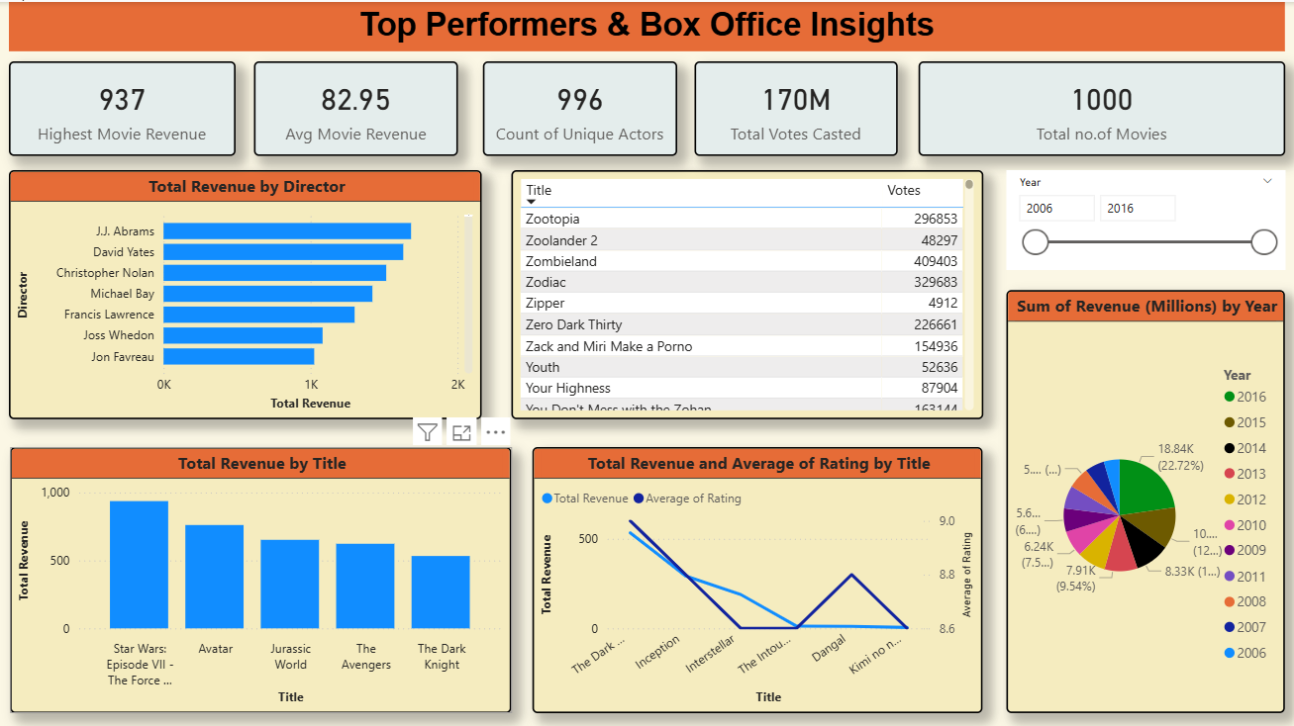

Slide 9
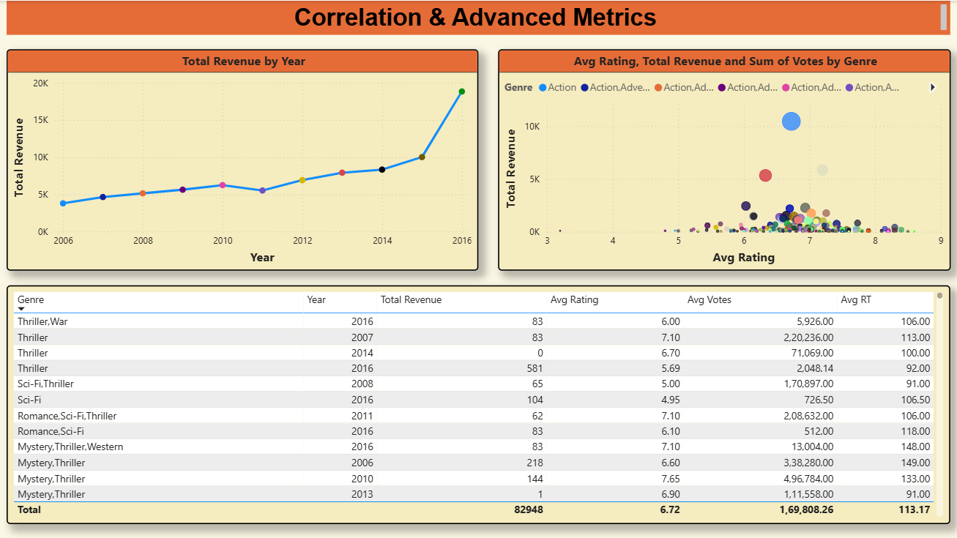

Slide 10
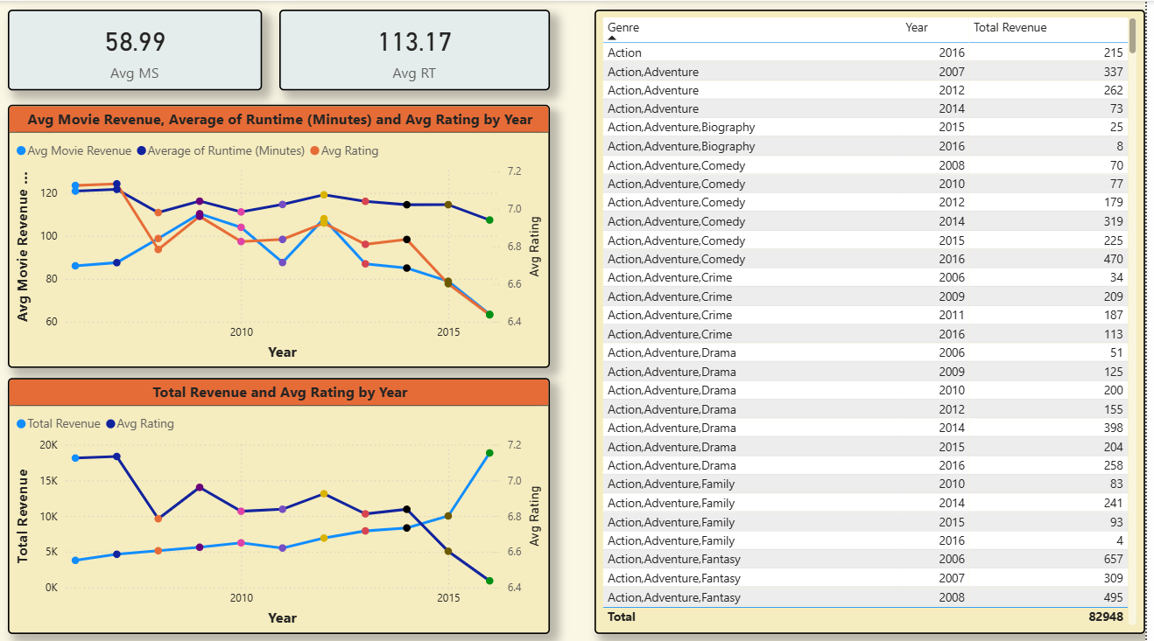

Slide 11
Key Insights
Trend Over Time:
Movie sales show fluctuations across years, reflecting changes in audience behavior and market conditions.
Genre Performance:
Certain genres consistently generate higher sales compared to others, showing clear audience preferences.
Ex:
Action, Adventure and Science -fiction Gener Movies.
Top Performing Movies:
A limited set of movies dominate box office collections, helping identify benchmarks for success.
Ex:
Star Wars, Avatar, Jurassic World, The Avengers
Revenue & Ratings Trend:
Movies can earn more money even if their ratings are low, because factors like marketing, popular actors, genre, and release timing strongly influence revenue.

Slide 12
Conclusion
In conclusion, this project successfully analyzed movie sales data to understand the relationship between box office revenue, movie ratings, and yearly performance trends.
Movie success is influenced by multiple factors, not just audience ratings. Some movies earned high revenue despite lower ratings.
Factors such as genre, marketing, star power, and release timing play an important role in a movie’s financial success.
In several years, total revenue increased even when average movie ratings declined.
Year-wise trends highlight fluctuations in both revenue and ratings due to changing audience preferences and market conditions.
Some movies achieved high revenue despite moderate or low ratings, emphasizing the business-driven nature of the film industry.

Slide 13
Recommendations
Focus on producing movies in high-performing genres such as Action, Adventure, and Sci-Fi, as these genres attract larger audiences and generate higher revenue.
Ensure high production quality and a strong cinematic experience, including visuals, sound, and storytelling, to improve audience satisfaction.
Invest in effective marketing and promotions to reach a wider audience and encourage viewers to share genuine ratings and reviews after watching the movie.
Maintain affordable ticket pricing to increase theatre footfall and attract a broader audience base.
Choose the most suitable release date based on market conditions, competition, and production house strategy to maximize revenue.
To attract younger audiences, consider producing animated and child-friendly movies, which have strong repeat-viewing potential.

Slide 14
Any
Questions?

Slide 15

THANK YOU

